Slide 1
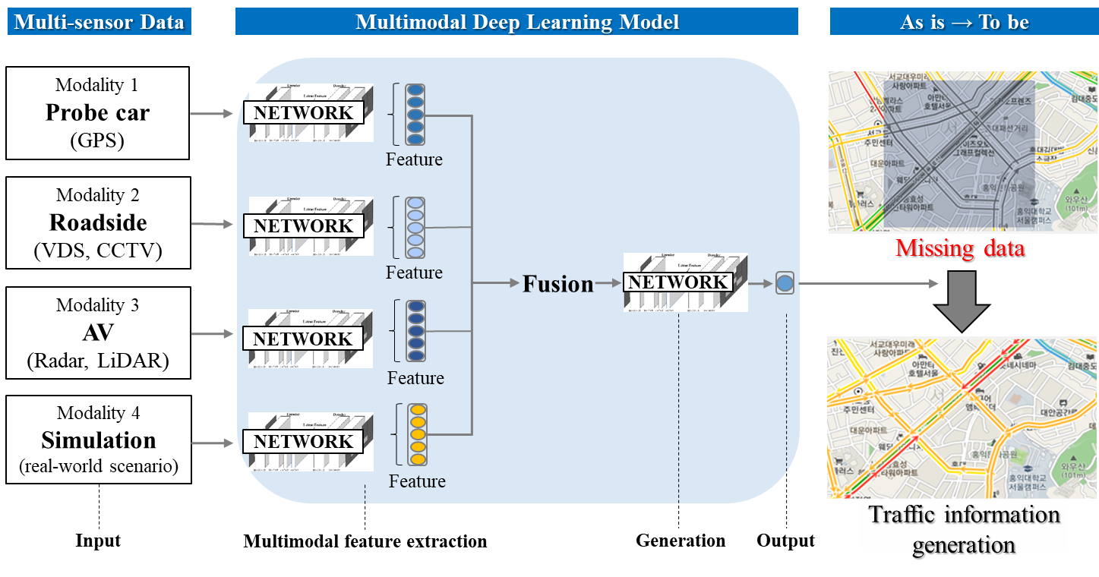
Multimodal deep learning for traffic information generation by fusing multi-sensor data Researcher: Jin Hong Min
What is the problem?
The cost constraints make it difficult to install traffic sensors in entire urban networks.
Most AV sensors has limitations in responding immediately and perfectly to real-world situations.
Most multi-sensor data is incomplete and has defects such as missing, limited, and sensor noise.
Why is this problem important?
Seamless, accurate, and reliable traffic information is critical to traffic planning and operational strategies.
The advancement of traffic information to support autonomous cooperative driving is essential (e.g., refinement of collected information, segmentation of collection section, etc.)
Direct integration and utilization of data collected from multi-sensors is difficult due to their different information features and spatiotemporal collection ranges.
Previous studies on generating traffic information for missing data segments by fusing multi-sensor data are insufficient.
How can we solve this problem?
Multi-sensor data has different characteristics and can be used as complementary information.
Proposed multimodal deep learning model aims to fuse different features from multi-sensor data.
Proposed multimodal deep learning model can generate high-resolution traffic flow information (e.g., lane-level volumes, speed, etc.).
What is key contribution?
Proposed model generates more accurate traffic information by fusing multi-sensor data.
Proposed model reduces the uncertainty of missing data and provides continuous and reliable traffic information.
Generated traffic information by the proposed model can be used to provide decision-support for operators.

